Slide 1
Evaluating Digital & Print Sources
Notes:
Lesson Objectives
Students will:
Learn to to use the SET tool, by answering questions within the tool, to evaluate digital and print sources.
Make critical decisions to select quality sources based on their usefulness, reliability, and if they are kid friendly.

Slide 2
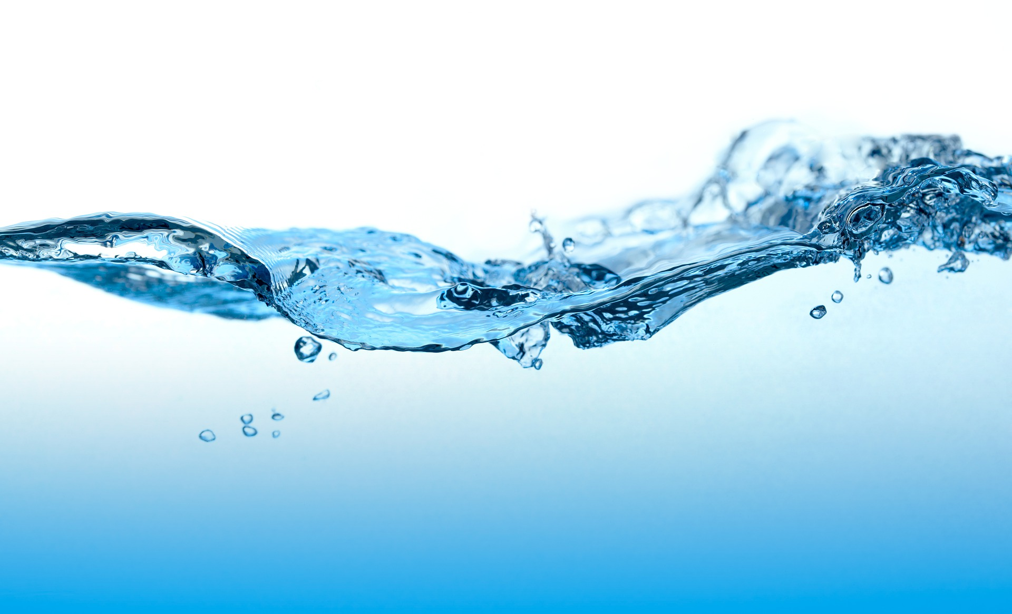
How do we use water?
Can you think of all the ways you use water?
What is most important about the water you use?
Does everyone have access to this type of water? Where would you find information to answer this question?
Notes:
Can you think of all the ways you use water?
What is most important about the water you use? (e.g. adequate amount, clean, accessible)
Not everyone has water with those characteristics.

Slide 3
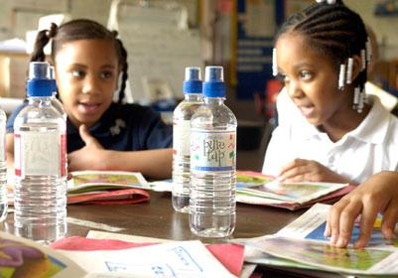
Cleaning Dirty Water
Huma and her friend Jamila have also been learning about water as a natural resource, and the Global water crisis. There are over 800 million people in the world who do not have access to clean drinking water. They want to help solve this problem and have decided to work together to invent a way to clean dirty water.

Slide 4
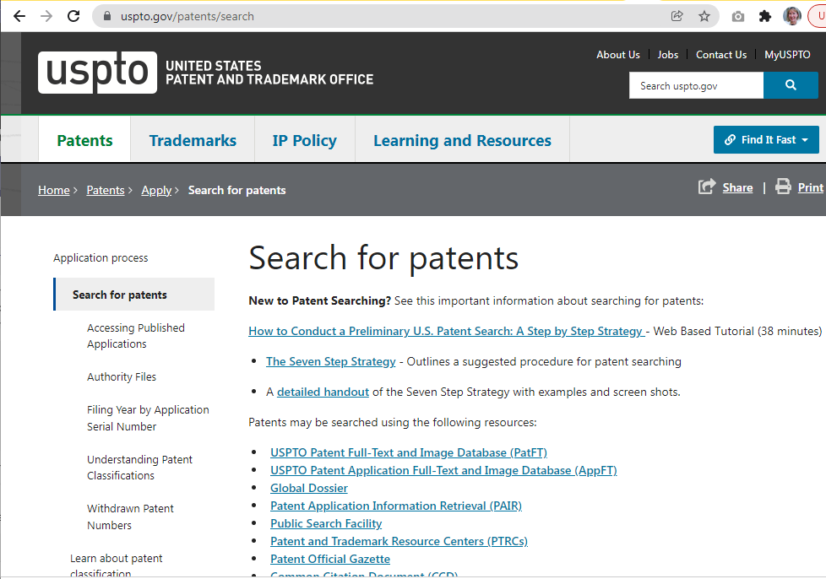
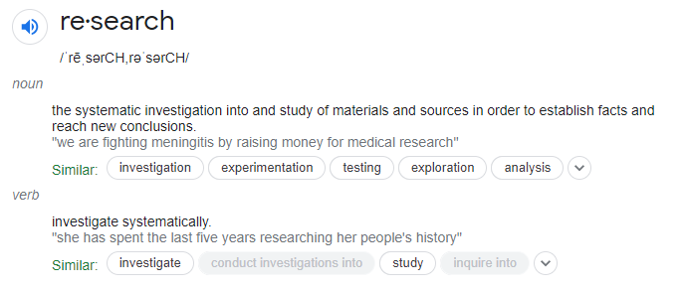
Huma and Jamilla have begun to research existing inventions on the United States Patent & Trademark Office (USPTO) website, which will tell them about solutions that have already been created.
Notes:
Teachers can mention that the USPTO website is a good place to find information about patents and patented inventions.

Slide 5
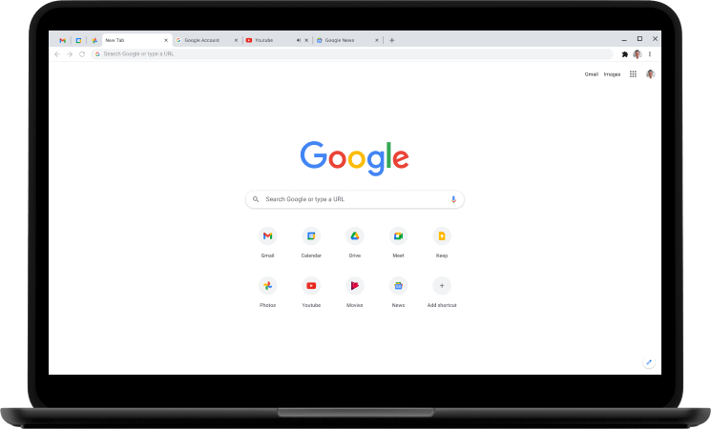
They also conducted a Google search, and have discovered an exciting product on a website that could give them some ideas of how to solve this problem.
Notes:
Click for arrow

Slide 6
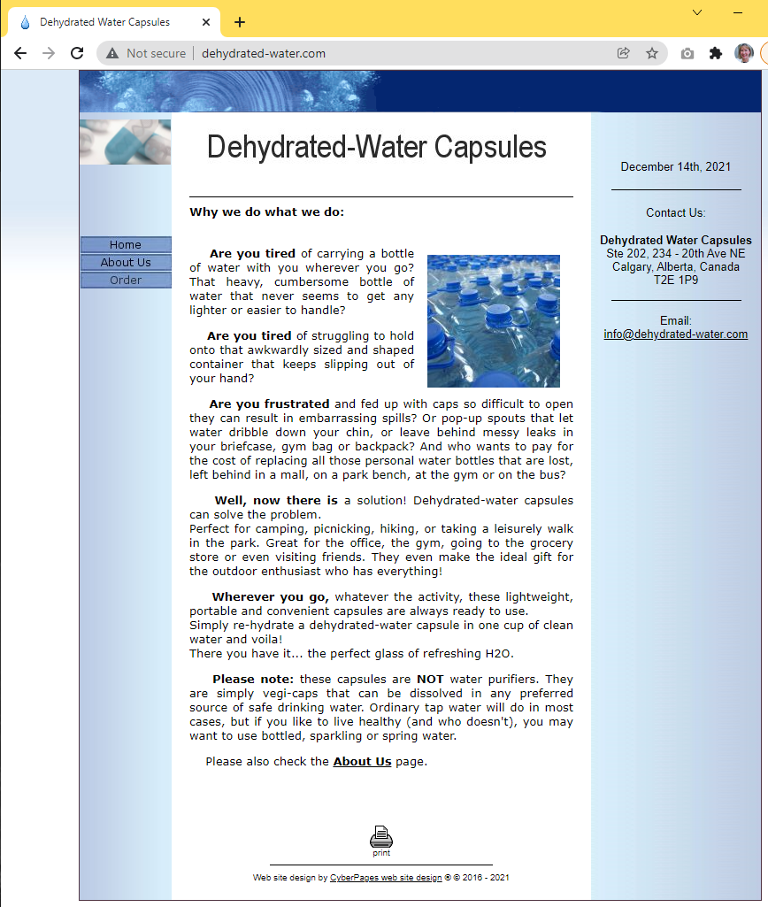
Let’s examine the website that was found on a Google search:
What problem does this product solve?
Is this website useful in helping Huma and Jamila solve their problem?
How can they be sure this a high quality source?
Notes:
Lead students through examining the website. They should discover that the “product” is bogus (you have to add water to the capsule to get water). If necessary ask questions to lead them to this understanding.

Slide 7
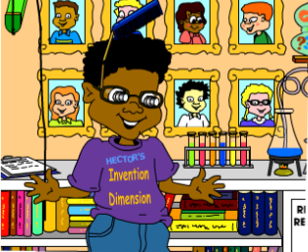
Meet Hector
Hector is a kid inventor from a town called Curiosity Creek. He is in 6th grade and loves to invent. Hector loves to help fellow inventors and will help us learn more about inventing and research.
Notes:
Click for arrow

Slide 8
Ask
Improve & Share
Imagine
Hector knows that successful inventors go through the engineering design process (EDP) that starts with identifying a problem and, hopefully, ends with finding a useful solution.
The Engineering Design Process
Test
Choose & Plan
Create & Build

Slide 9
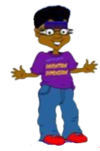
Ask questions
Conduct research
Make decisions
Click to see Hector’s questions!
During the EDP, inventors:
Who has the problem?
How many people does it affect?
Ask
How can I improve my design?
Is my idea original?
Improve & Share
Imagine
How is the problem currently being solved?
Are there existing inventions that can help?
Test
Choose & Plan
What is the best solution? It is original?
Can you combine several solutions to create a unique product?
What methods can help you test your prototype?
Create & Build
What existing technology can help you create a prototype?

Slide 10
It is important to make sure that the resources and information we use to answer questions and make decisions are high quality. If we don’t do that, we could go in the wrong direction, like Huma and Jamilla. That could result in wasting precious time, money and effort. Yikes!!
But don’t worry… Get SET! is here to help!

Slide 11
Get SET!
Source Evaluation Tool
Notes:
Click for arrow

Slide 12
What does Get SET! do?
Get SET! is a tool to help you evaluate a source
It is quick and easy to use!

Slide 13
Get SET! focuses on 3 categories
Useful
Reliable
Kid-Friendly
We will explore what each of these categories mean in order to evaluate a source.

Slide 14
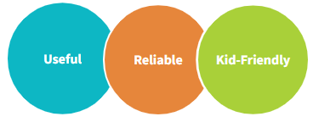
How does Get SET! work?
You will answer questions in each category to help you evaluate a source.
Then check the box that best describes how much you agree or disagree:
___Strongly disagree.
___Somewhat disagree
___Somewhat agree
___Strongly agree

Slide 15
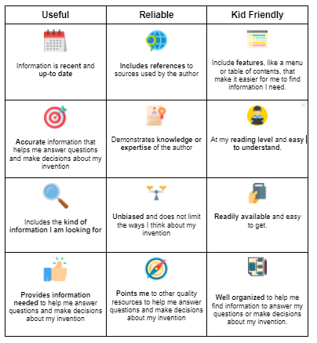
Hector will guide us in using the tool to evaluate some new sources Huma and Jamilla have found.
Get SET!
This grid will help us learn more about the criteria for each category.

Slide 16
What is a Useful Source?
Huma and Jamila want to learn more about the problem of dirty drinking water. What phase of the engineering design process is this?
Ask
Who has the problem?
How many people does it affect?
Notes:
Click through to reveal the rest of the slide.

Slide 17
A Useful Resource
Contains information is recent and up-to date
Provides accurate (truthful or factual) information to help me answer questions and make decisions about my invention.
Includes the kind of information I am looking for
Provides much of the information needed to help me answer questions and make decisions about my invention
Notes:
Teacher will read through each of the descriptions.

Slide 18
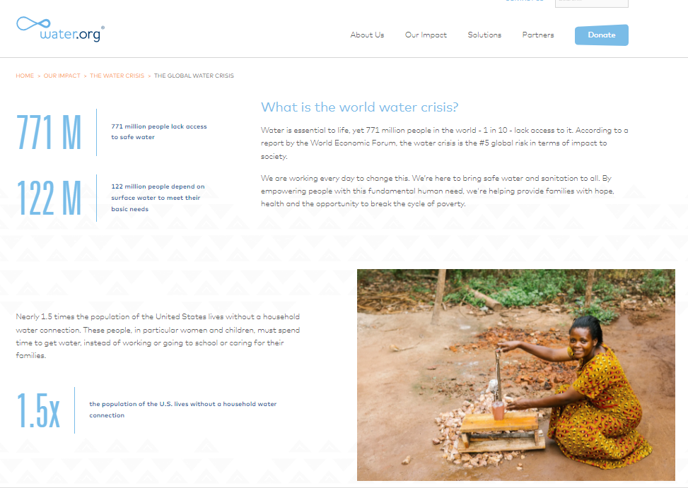
Is this source Useful?
www.water.org
Notes:
Click on the website to have it open on the screen. Guide students through these prompts which align with the Get SET! Grid:
Contains information is recent and up-to date ☑ Dated references are included at the bottom of the web page
Provides accurate (truthful or factual) information to help me answer questions and make decisions about my invention. ☑ References at bottom of page (this may be tricky for younger students)
Includes the kind of information I am looking for ☑ Answers the question of who has the problem and how many people it affects.
Provides much of the information needed to help me answer questions and make decisions about my invention
☑ Yes
☑ This source is useful!

Slide 19
What is a Reliable Source?
Huma and Jamila want to learn more about how the problem is currently being solved. This is the Imagine phase of the EDP. They need to make sure they can depend on it being true, especially since they were fooled by the Dehydrated Water website.
Imagine
How is the problem currently being solved?
Are there existing inventions that can help?
Notes:
Click through to reveal the rest of the slide.
Ask the students:
What does the word "reliable" mean?
Can you give me an example from your own life?
If something is reliable, you can depend on it.

Slide 20
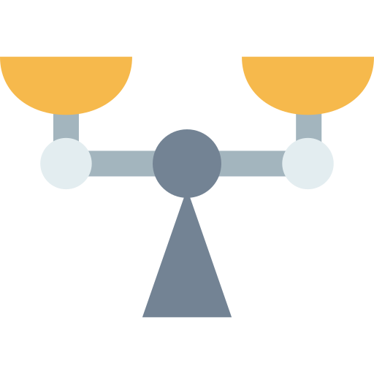
A Reliable Resource
Includes references to the sources used by the author
Demonstrates knowledge or expertise of the author
Is unbiased and does not limit the ways I think about my invention
Points me to other quality resources to help me answer questions and make decisions about my invention
Notes:
Teacher will read through each of the descriptions.

Slide 21
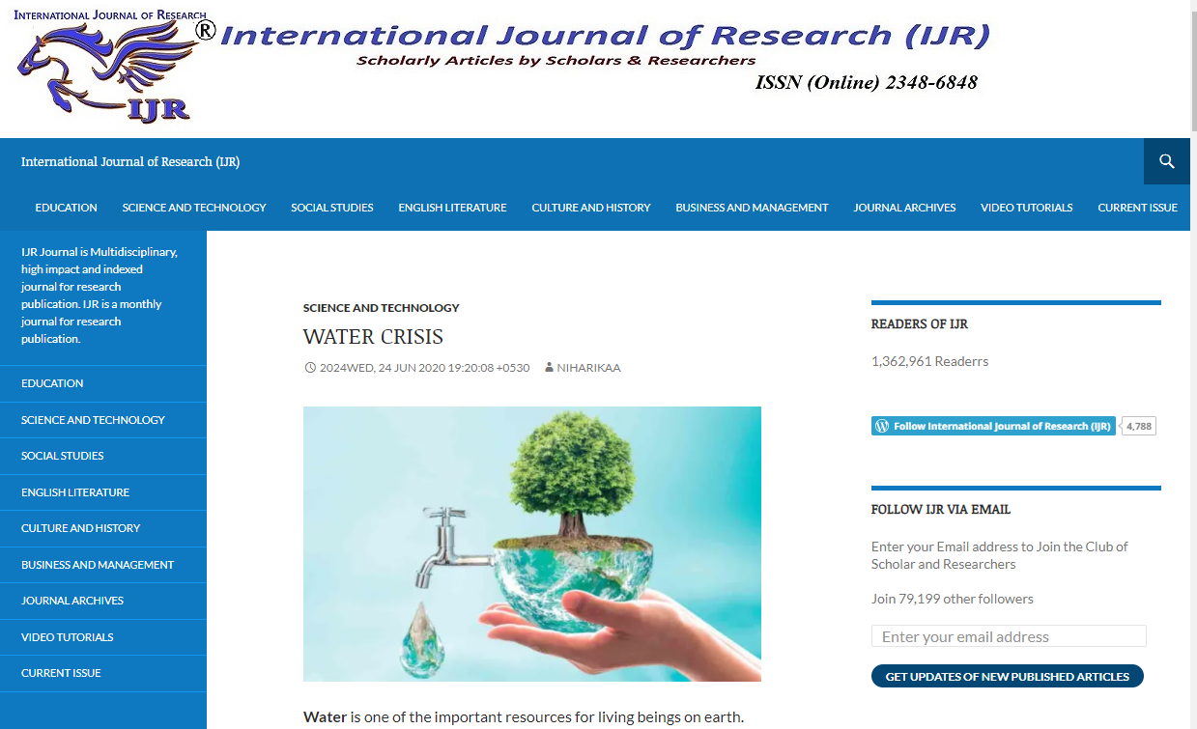
Is this source Reliable?
International Journal of Research
Notes:
Huma and Jamila want to learn more about how the problem is currently being solved. They need to make sure they can depend on it being true, especially since they were fooled by the Dehydrated Water website.
Click on the website to have it open on the screen. Guide students through these prompts which align with the Get SET! Grid:
Includes references to the sources used by the author ☑ There are 2 references cited
Demonstrates knowledge or expertise of the author ❌ Author is not fully named, lots of spelling and capitalization errors
Is unbiased and do not limit the ways I think about my invention ❌The solutions for solving the problem are not substantiated and might be opinions
Points me to other quality resources to help me answer questions and make decisions about my invention
☑ There are 2 references that can be looked up.
❌ This source is not reliable, Huma and Jamilla should find another source to evaluate.

Slide 22
What is a Kid-Friendly Source?
Huma and Jamila want to experiment with different filtering methods to create a solution to filter water. What part of the EDP is this?
Choose & Plan
What is the best solution? It is original?
Can you combine several solutions to create a unique product?
Notes:
Click through to reveal the rest of the slide.

Slide 23
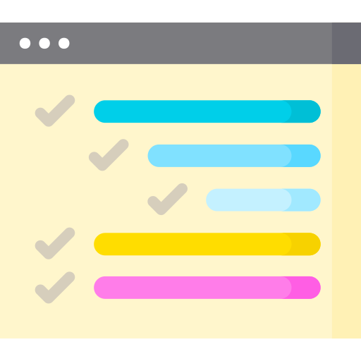
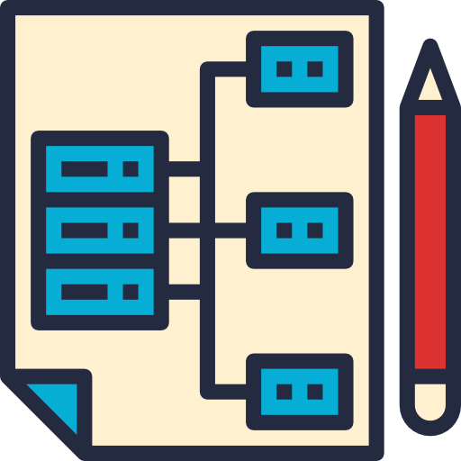
A Kid-Friendly Resource
Includes features, like a menu or table of contents, that make it easier for me to find information I need.
Is at my reading level and easy to understand.
Is readily available and easy to get.
Is well organized to help me find information to answer my questions or make decisions about my invention.
Notes:
Teacher will read through each of the descriptions.

Slide 24
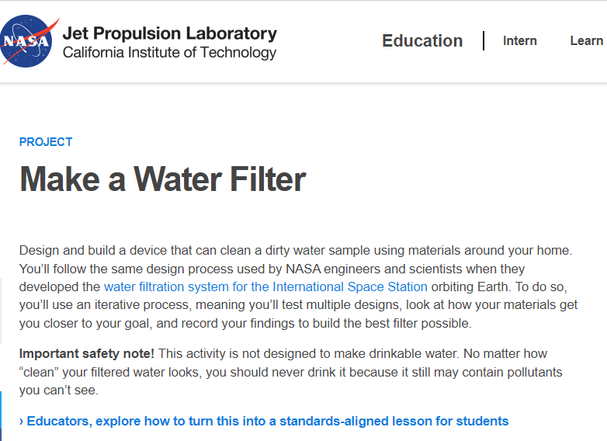
Is this source Kid-Friendly?
NASA Project: Make a Water Filter
Notes:
Click on the website to have it open on the screen. Guide students through these prompts which align with the Get SET! Grid:
Includes features, like a menu or table of contents, that make it easier for me to find information I need. ☑ Contains a materials list, “Jump To” box, and step -by-step instructions.
Is at my reading level and easy to understand. ☑ The information is easy to follow and has pictures to help me understand.
Is readily available and easy to get. ☑ The information is available from the NASA website.
Is well organized to help me find information to answer my questions or make decisions about my invention. ☑ The source shows how to build a water filter which will help give Huma and Jamilla understand how to clean water and how this might be used in their invention.
☑ This source is Kid-Friendly

Slide 25
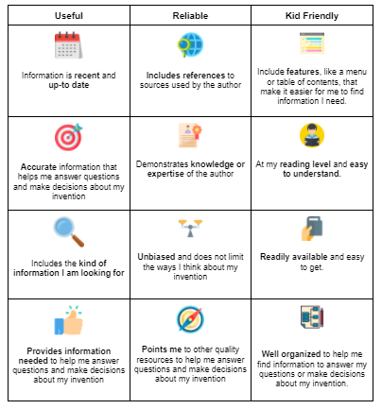
Good Job!
You now know how to use the Get SET! categories to evaluate a source.
Notes:
Click for arrow

Slide 26
Get ready for our next Get SET! lesson
Bring in a source you would like to evaluate that is related to your invention.
You will use the tool to learn if your source is Useful, Reliable, and Kid Friendly.
Notes:
Click for arrow

Slide 27
Resources
Icons provided by
www.freepik.com
www.flaticon.com

